Slide 1


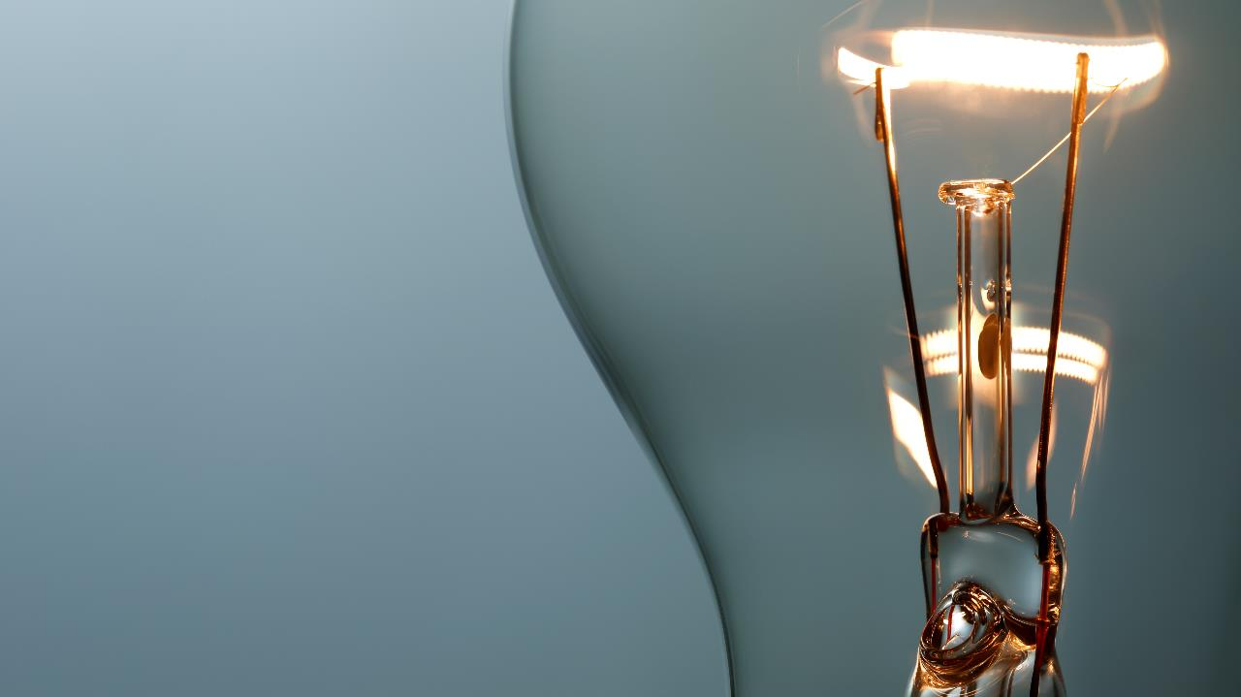
Sign Language Recognition System
Guided By: Prof.(Ms)Mohini.aRote.
PES Modern College of Engineering College
Project Members:
Suraj Gawade
Aditya Pise
Geet Lakhe
Saurabh Kumatkar

Slide 2

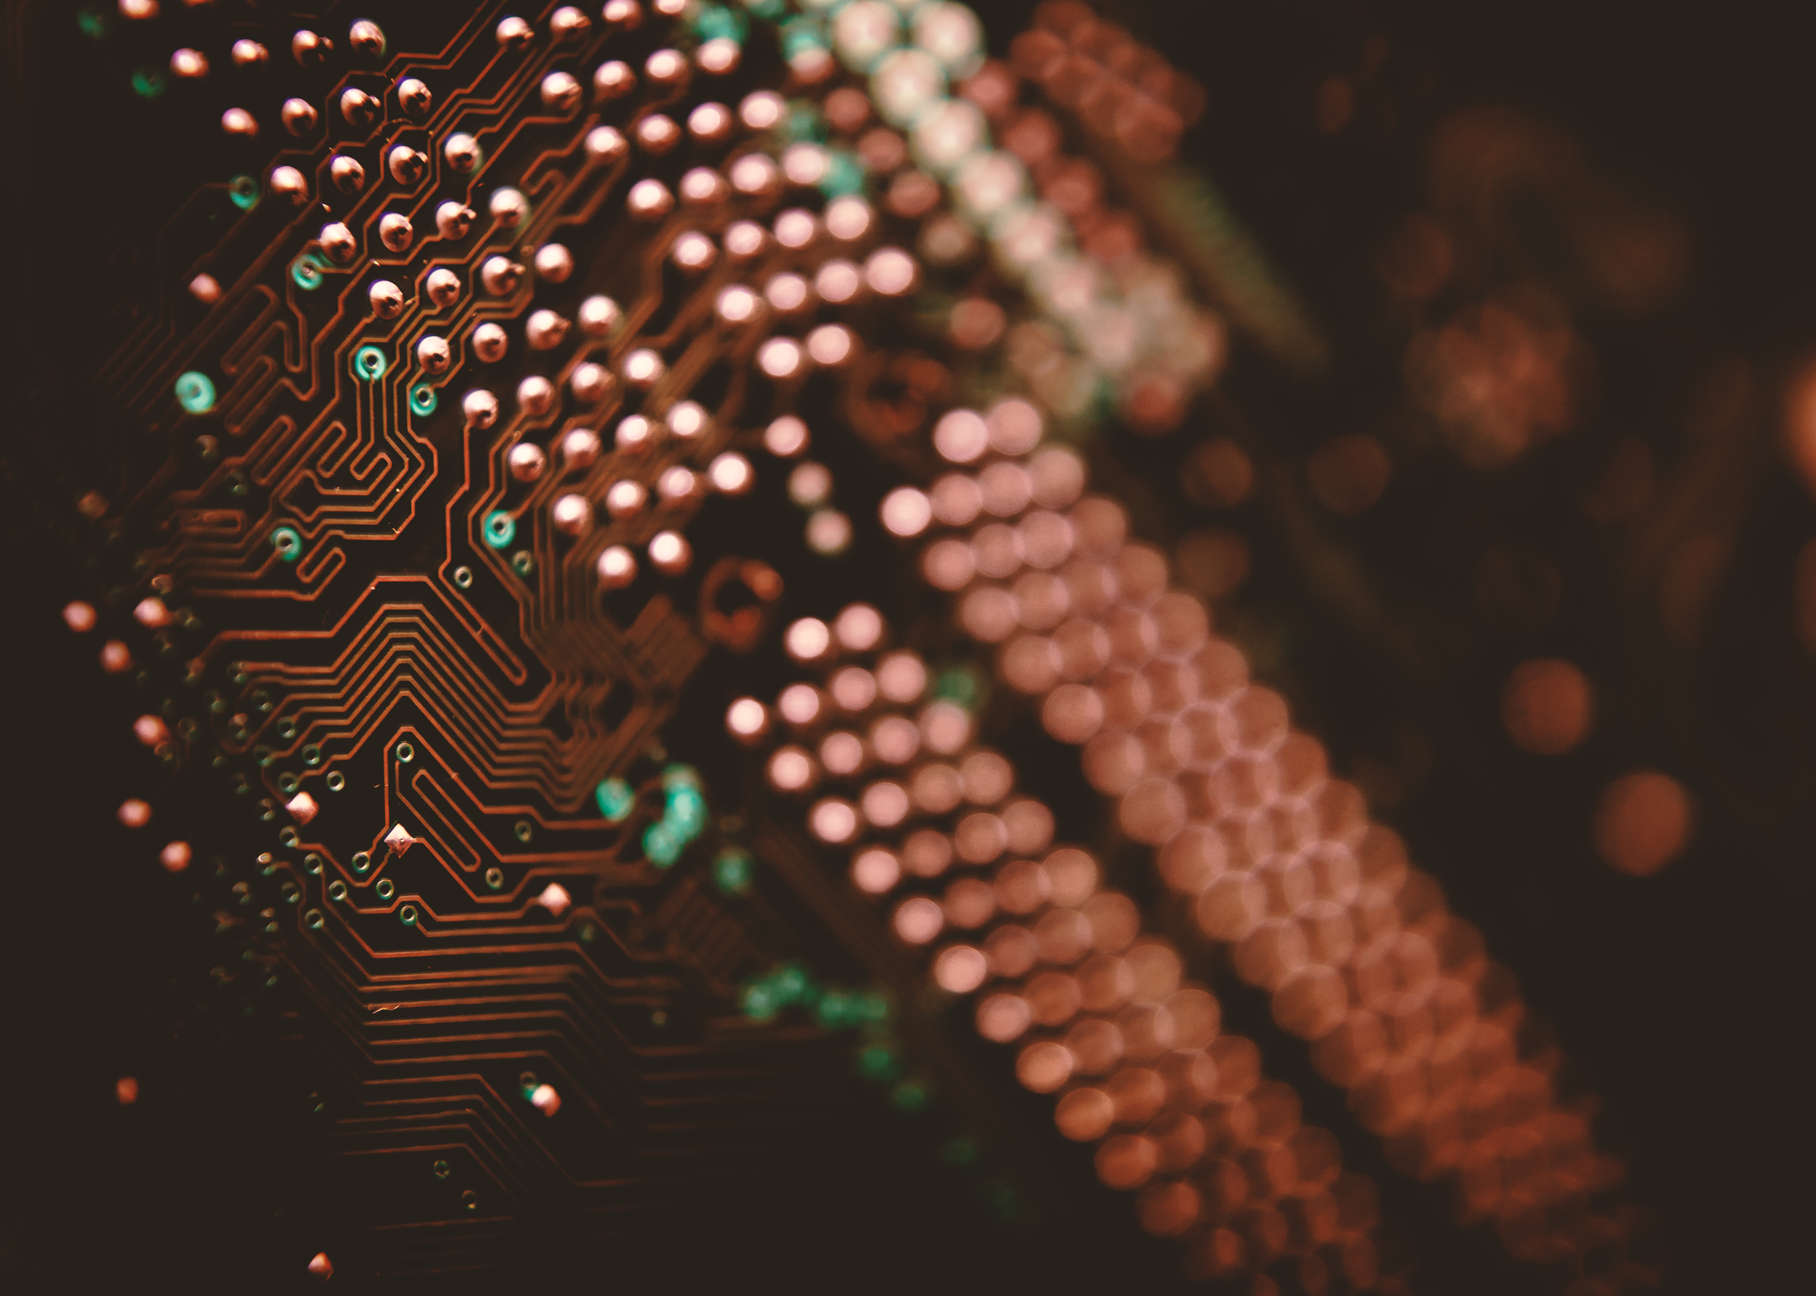
Agenda
1. Title Slide
2. Introduction
3. Problem Statement
4. Scope
5. Objective/ Need
6. Literature Survey
7. Architectural Block Diagram
8. References

Slide 3
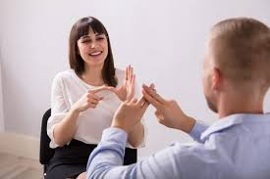
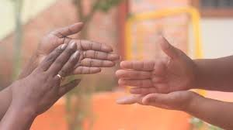
introduction
Sign language is a type of language that uses manual communication to convey meaningful messages to other people. This includes simultaneous employing of hand gestures, movement, orientation of the fingers, arms or body, and facial expressions to convey a speaker's ideas.
American Sign Language is one of the popular sign
language used by most of deaf and dumb people to
communicate with each other.

Slide 4
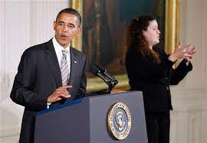
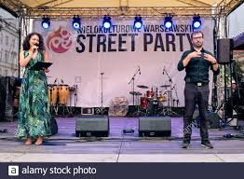
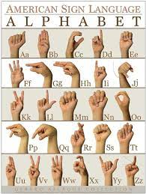
A real-time sign language translator is required for facilitating communication between the deaf community and the general public.
We propose a system called Dynamic tool for American Sign Language (ASL) finger spelling interpreter which can consistently classify the letters a-z.

Slide 5
Problem Statement
To provide user with a system called Dynamic tool for American Sign Language(ASL) finger spelling interpretation which can consistently classify the letters a-z.

Slide 6
Scope
Hand gestures can be applied in the field of telemedicine or surgery and even in locking systems.
Industrial robots can also take an advantage of hand gestures.
The use of hand gesture based system in public places such as ATM, railway station for booking of platform ticket etc.

Slide 7
NEED:
Dumb people are usually deprived of normal communication with other people in the society.
Also normal people find it difficult to understand and communicate with them.
These people have to rely on an interpreter or on some sort of visual communication. An Interpreter won’t be always available and visual communication is mostly difficult to understand.
At this age of technology, it is quintessential to make these people feel part of the society by helping them communicate smoothly. Hence an Intelligent Computer System is required to be developed and be taught.
OBJECTIVES:
Create a Machine Learning model for Sign Language Interpretation.
Studying and understanding ASL guided symbols along with basics of machine learning.
Learning of frame extraction through video along with implementation of canny edge detection algorithm.
Classifying ASL gestures as per English alphabet and conversion of ASL gestures to speech.

Slide 8
Literature Survey
Sr.no | Title | Author | Publication And Year | Method used | Remark
1. | Research of a Sign Language Translation System Based on Deep Learning | Siming He Ridley College, St. Catharines, Canada | IEEE Transactions of Knowledge and Engineering. 2019 | R-CNN LSTM | Experimental results show that the recognition rate of this method is up to 99% in common vocabulary data set, which is better than other known methods.
2. | Indian Sign Language Recognition: Database creation, Hand tracking and Segmentation | Purva A. Nanivadekar Vaishali Kulkarni | IEEE Transactions of Knowledge and Engineering. 2014 | INSPEC: Controlled Indexing. INSPEC: Non-Controlled Indexing 3-Step Algorithm | The results demonstrates working of motion tracking, edge detection and skin color detection individually as well as their combined effect.

Slide 9
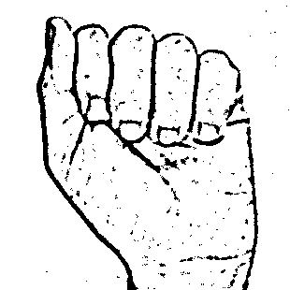
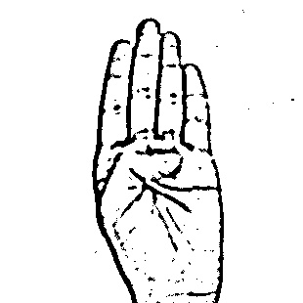
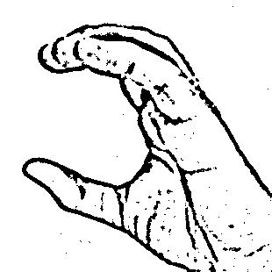
DATASET:

Slide 10
SySTEM CONFIGURATION:
Hardware Requirement
1) Operating System – Windows 8 or Above
2) Processor – Intel Quadcore
3) Memory – 2 GB or Above
4) HDD – 40 GB or Above
Software Requirement
1) Python Interpreter
2) Python Libraries – Pandas, Keras, TensorFlow, Numpy, Scikit-Learn.
3) Python GUI.

Slide 11
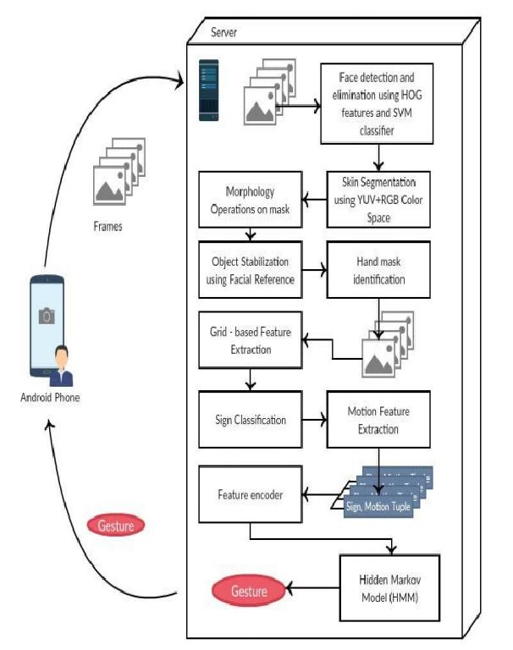
Architectural Block Diagram

Slide 12
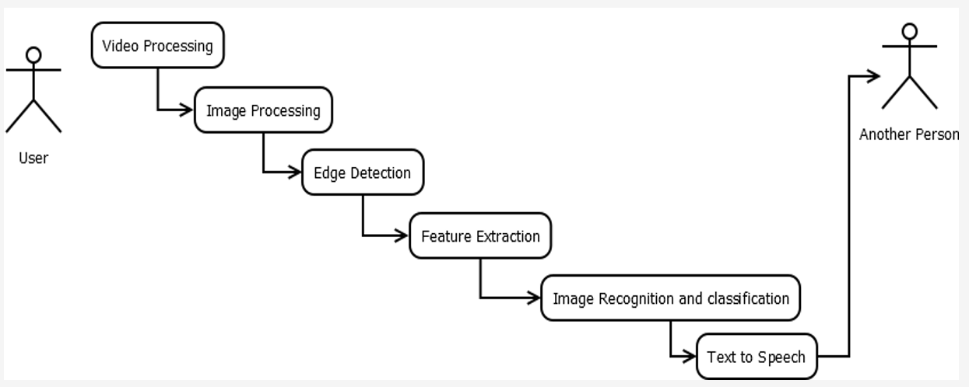
B-UML Diagram

Slide 13
REFERENCES:
Convolutional Neural Networks:
https://en.wikipedia.org/wiki/Convolutional_neural_network
2) OpenCV Tutorials:
https://docs.opencv.org/master/d6/d00/tutorial_py_root.html
3) Sign Languages:
https://en.wikipedia.org/wiki/Sign_language
4) Machine Learning :
https://www.mygreatlearning.com/blog/machine-learning-tutorial/

Slide 14
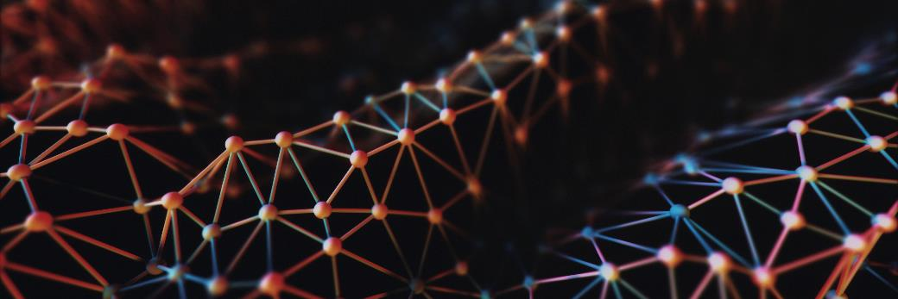
Thank you

